Slide 1
Why PM Discipline Now?
Mitsuru Saito
Principal Product Manager
Rakuten.inc
Notes:
Agenda
Introduction
What’s pm
Some experiences based topic

Slide 2
Introduction
PM
Windows/IE/OE
Microsoft Japan
PM
Windows
Microsoft HQ
PM
Rakuten Travel Rakuten.inc

Slide 3

Each Org Should Have Each Style of PM
PM is well defined in books?

Slide 4

Define and design products and services that delight customers
and add strategic value to the company.
What’s PM?

Slide 5
Triangle of Company
Sales
Product (Development)
Marketing

Slide 6
Triangle of Product
Product
（Development)
Developers
Sales
PM
QA
Product (Development)
Marketing

Slide 7
Responsibility
PM
Scenarios
Developer
Efficiency (Cost and Performance)
Quality of products
Each Service Owner
Benefit and revenue
Technology
QA
Customers
End Users
Products
Sponsor

Slide 8
Responsibility
PM
Scenarios
Developer
Efficiency (Cost and Performance)
Quality of products
Each Service Owner
Benefit and Revenue
Technology
QA
Customers
End Users
Sponsor
Products
PMs Think about End to End

Slide 9
System in General
CPU/Memory/Device
Middleware (OS API, System setting, Browser (Engine), App Interface)
UX
Interface

Slide 10
System in General
CPU/Memory/Device
Middleware (OS API, System setting, Browser (Engine), App Interface)
Interface
UX

Slide 11
System in General
UX PM
Protocol PM
CPU/Memory/Device
Abstraction Layer
UX
Interface
Physics PM

Slide 12

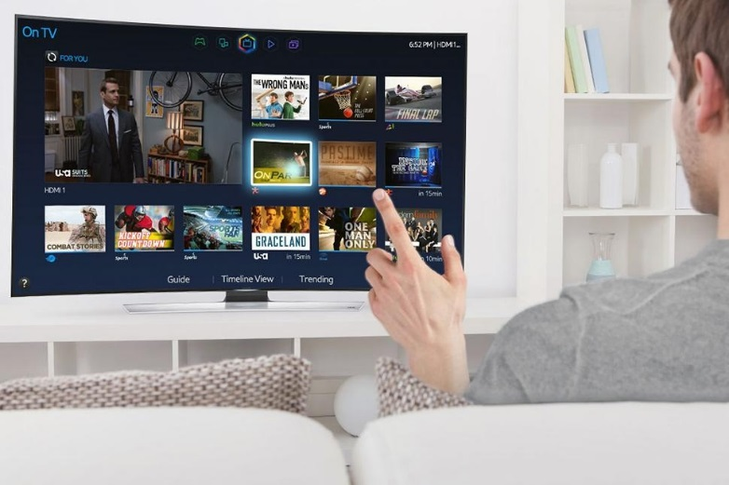
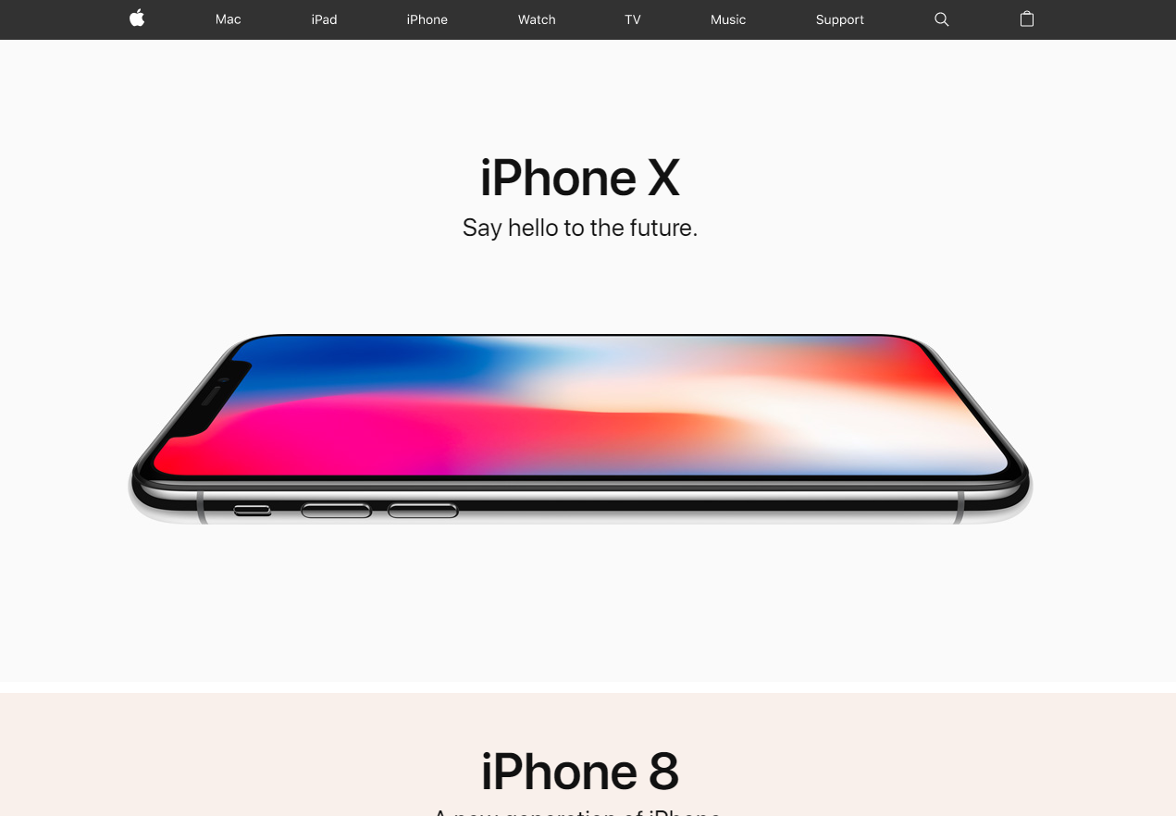
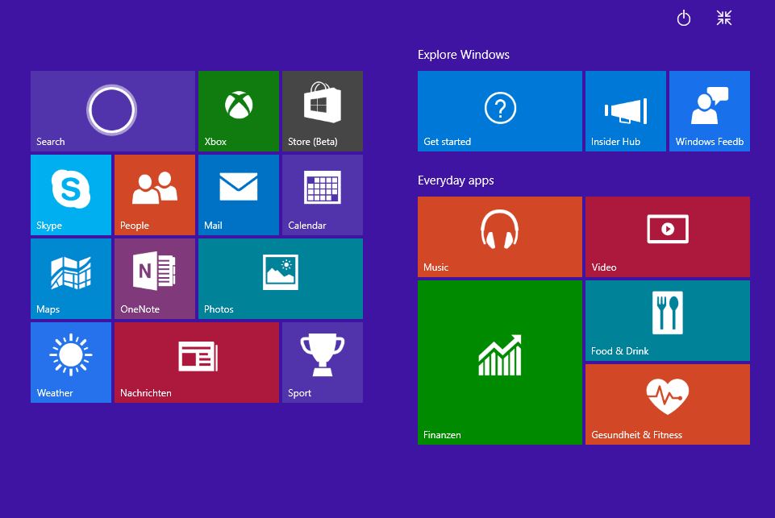
UX PM

Slide 13
PM Defines Interfaces
Products
Customer
Partners
Industry
Users
3rd party
Government
You name it but **** PM

Slide 14
Three Pillars of Talents
Generalize
Decision Making
Communication Skill

Slide 15
Generalize

Slide 16
PM is not required if s/he solves each issue one by one

Slide 17
Simplify data and protocol
Random Goal
Issue
Issue
Issue
Goal
Requirement
Requirement
Requirement

Slide 18
Simplify data and protocol
Goal
Requirement
Goal
Requirement
Requirement
Requirement

Slide 19
Generalize
Culture
Personality
Services
Data type
Action/Method
Categorization

Slide 20
Communication Skill

Slide 21
95% of PM Work is Disgusting

Slide 22
Communication Path
You
Manager
Stakeholders
Customer
Team Mates
Developers

Slide 23
The more users on your product The more you feel you are alone

Slide 24
Criticism on you
You
Partners
Users
Friends
Mass Communication
Co-worker
Family
Notes:
You
Partners
External Partners, Internal Partners
Users
SNS, Board, Chat, Mail, CS
Mass Communication
News, TV, web site
Co-worker
Friends, Family, Relatives, Siblings

Slide 25
Tendency of Reaction
Block Ears
Escape from the situation
Stop thinking about your feature
Care only Short Site
Care only Closest Guys
Notes:
Do not listen to anything
Stop thinking about your feature
Care only closest guys
Care only Short site
Escape from the situation

Slide 26
Feedback is always great! People use your products!

Slide 27
Decision Making

Slide 28
Its your product! Make a decision by yourself!

Slide 29
You get tons of feedback
You
Manager
Stakeholders
Customer
Team Mates
Research

Slide 30
Be Responsible for Your Product
Authority
Explanation
Confidence
Knowledge
Flexibility

Slide 31
As My Last Message…

Slide 32
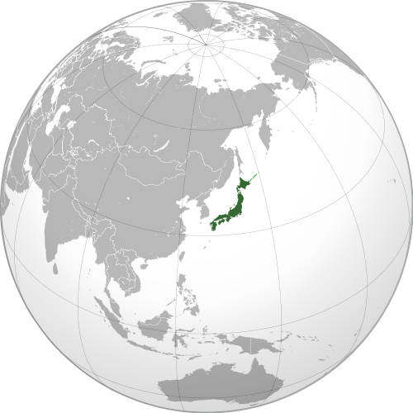


Developing
is Always
Fun☺

